Slide 1

Winter 2022
University of Michigan
COVID-19 Vaccine Sentiment Analysis
Elizabeth Choi
Yena Kim
Arjun Padmanabhan
Kashmira Sawant
Sunny Singh

Slide 2
Agenda
Research Background & Motivation
Hypotheses Development
Methodology
Research Results
1

Slide 3



I
Research Background & Motivation
COVID Vaccine
- > 10.7 billion doses
- Benefits of vaccination
- Misinformation
2

Slide 4
II
Hypotheses Development
Hypothesis 1
Hypothesis 2
There will be a difference in sentiment towards the COVID-19 vaccine depending on a state’s political affiliation (Red vs Blue)
Geographic locations with lower socioeconomic status will have lower rates of vaccination and more negative sentiments towards vaccinations
Hypothesis 3
As vaccinations become authorized by health organizations, and widely used, sentiments regarding the vaccine will become more positive
3

Slide 5


III
Methodology
Tweets
Geolocation
- snscrape
- 222,232 total tweets
- 3,500 testing data
- Data collected
-GeoPy module
- 123, 607 tweets
- 6607 tweets were removed from the dataset with irrelevant locations.
- 60,605 tweets - Geotagged as United States
Manual Sentiment Coding
- Train data - 2000
- Test data - 1500
- Labeling sentiment of tweets (Positive, Negative, Neutral, Irrelevant)
- Location of tweets
4

Slide 6
III
Methodology
Sentiment Analysis Model: Data Cleaning
Content Cleaning
Class Encoding
Tokenized Vectors
Class Imbalance
Rules based approach to tweet content cleaning
Extraction of:
hashtags
Removal of:
hyperlinks
user @’s
non-alphabetical characters
special characters
Positive
[Label == 1.0 & Irrelevant != 1.0]
Neutral
[Label == 0.0 & Irrelevant != 1.0]
Negative
[Label == -1.0 & Irrelevant != 1.0]
Irrelevant
[ Irrelevant == 1.0]
Initially passed max_length = 47
optimal max_length, k, such that 90% of all tweets are below this length
Compared model performance for:
max_length = 47
max_length = 512 (max length for BERT models)
High degree of imbalance in our training dataset
Positive: 53.9%
Neutral: 20.3%
Negative: 15.9%
Irrelevant: 9.9%
Overweighting of minority classes
Positive: 1
Neutral: 2.66
Negative: 3.39
Irrelevant: 5.46
Validated using cosine similarity
5

Slide 7
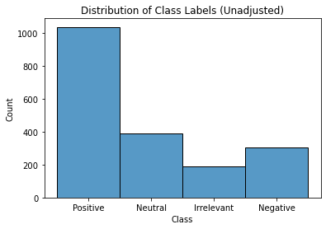
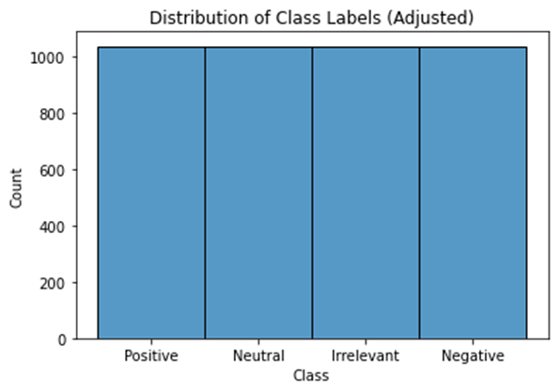
III
Methodology
Sentiment Analysis Model: Data Cleaning
6

Slide 8
III
Methodology
Sentiment Analysis Model: Initial Model Selection
Compared model performance for 7 different pre-trained models
model_ctb_v1 = digitalepidemiologylab/covid-twitter-bert
This model was trained on 160M tweets collected between January 12 and April 16, 2020 containing at least one of the keywords "wuhan", "ncov", "coronavirus", "covid", or "sars-cov-2".
model_ctb_v2 = digitalepidemiologylab/covid-twitter-bert-v2
97M unique tweets (1.2B training examples) collected between January 12 and July 5, 2020 containing at least one of the keywords "wuhan", "ncov", "coronavirus", "covid", or "sars-cov-2".
model_bcb_c = vinai/bertweet-covid19-base-cased
23M COVID-19 English Tweets (cased)
model_bcb_u = vinai/bertweet-covid19-base-uncased
23M COVID-19 English Tweets (uncased)
model_bb = vinai/bertweet-base
850M English Tweets (cased)
model_vct = ans/vaccinating-covid-tweets
850M General English Tweets (Jan 2012 to Aug 2019), with 23M COVID-19 English Tweets, pre-trained on COVID-19/vaccined related tweets using a masked language modeling (MLM) objective starting from BERTweet
model_msc = clampert/multilingual-sentiment-covid19
trained on a large-scale (18437530 examples) dataset of multi-lingual tweets that was collected between March 2020 and November 2021 using Twitter’s Streaming API with varying COVID19-related keywords
7

Slide 9
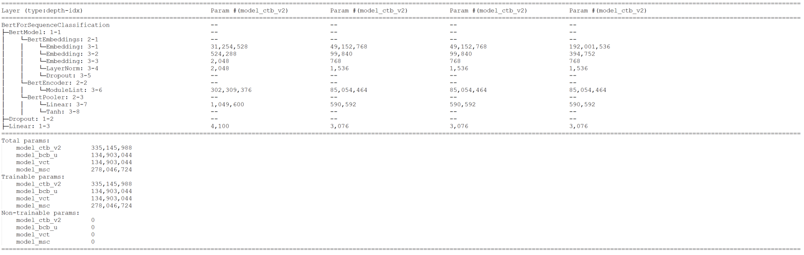
III
Methodology
Sentiment Analysis Model: Model Summaries
First pass-through:
The model tokenization & performance were nearly identical for model_ctb_v1 & model_ctb_v2, as well as model_bcb_c, model_bcb_u, and model_bb
Final set of models were:
model_ctb_v2
model_bcb_u
model_vct
model_msc
8

Slide 10
III
Methodology
Sentiment Analysis Model: Model Fine-Tuning
Hyperparameters:
Our hyperparameters when running the models included the following specifications:
Using an AdamW optimizer with a learning rate of 1*10^-5 and a EPS of 1*10^-8
Epochs = 4
Scheduler with number of warm-up steps = 0 and the number of training steps equal to the length of our data loader multiplied by the number of epochs (4).
Evaluation Metrics:
F1 Score (Weighted)
Model | Epoch 1 | Epoch 2 | Epoch 3 | Epoch 4
model_ctb_v2 | 0.67 | 0.77 | 0.81 | 0.82
model_bcb_u | 0.18 | 0.38 | 0.53 | 0.53
model_vct | 0.11 | 0.32 | 0.60 | 0.60
model_msc | 0.13 | 0.37 | 0.53 | 0.53
9

Slide 11
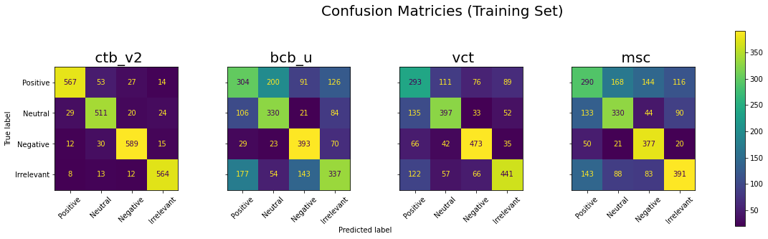
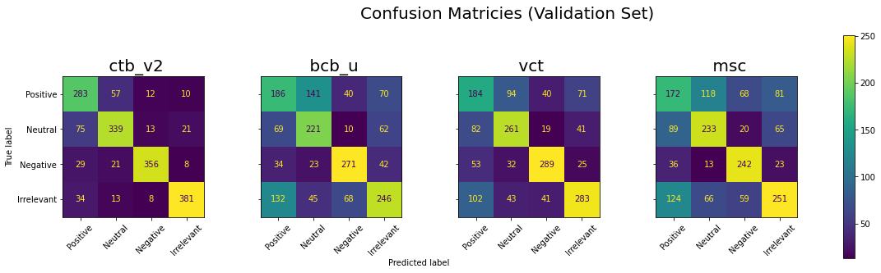
III
Methodology
Sentiment Analysis Model: Model Fine-Tuning
10

Slide 12
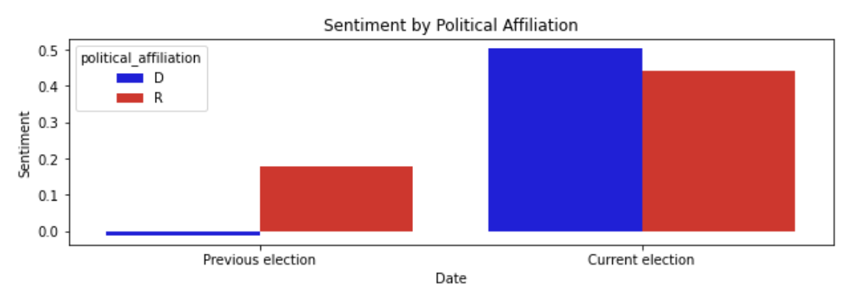
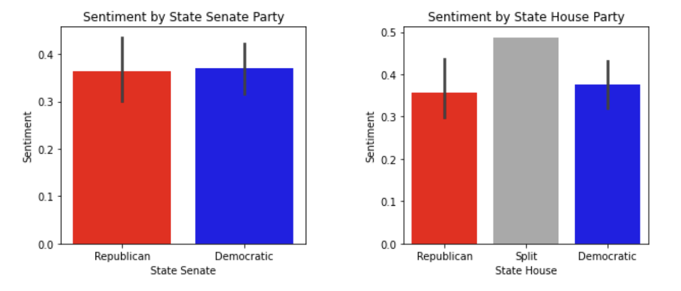
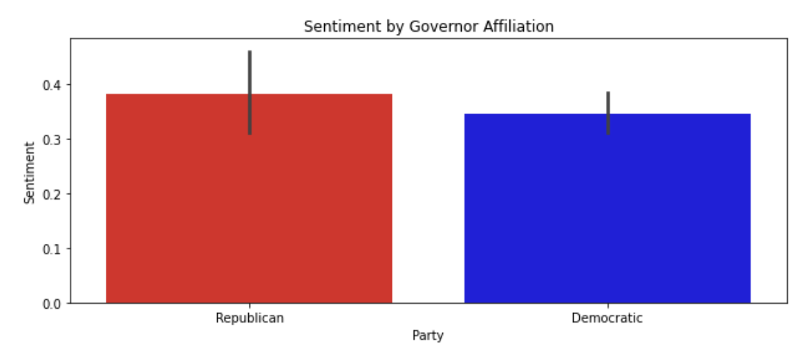
IV
Research Results
Red vs. Blue states
Presidential Election
Governors
3. State Senate and State House
11

Slide 13
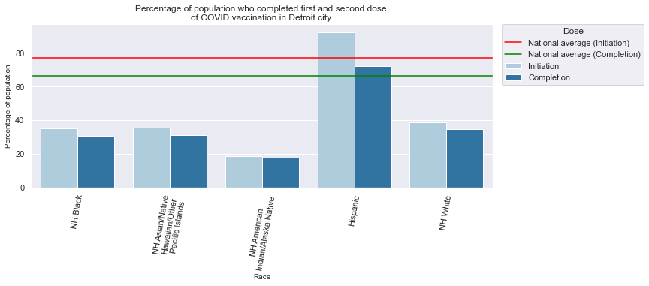
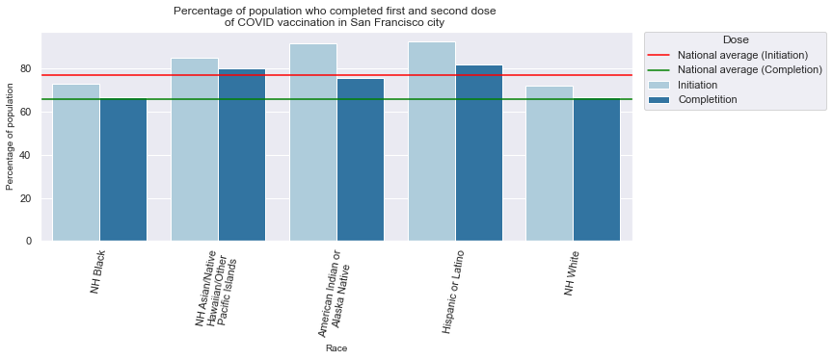
IV
Research Results
Socioeconomic Status
COVID-19 Vaccination Progress
Detroit, MI
San Francisco, CA
14

Slide 14
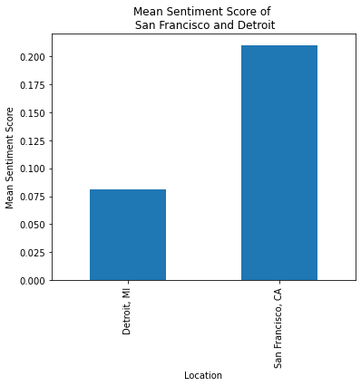
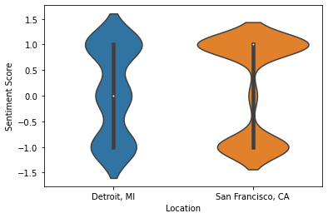
Sentiment Analysis
15

Slide 15
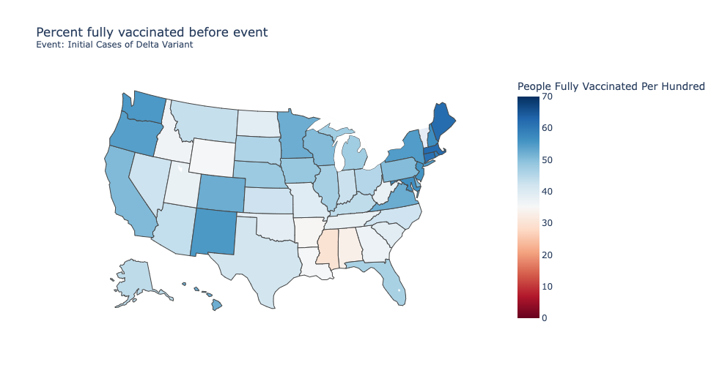
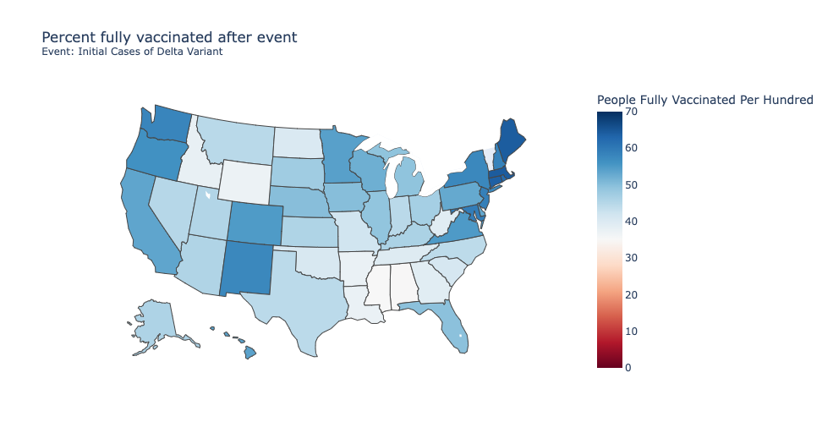
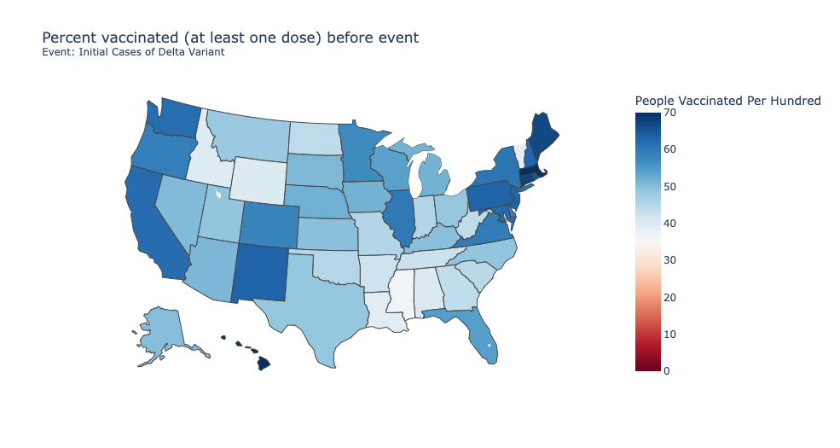
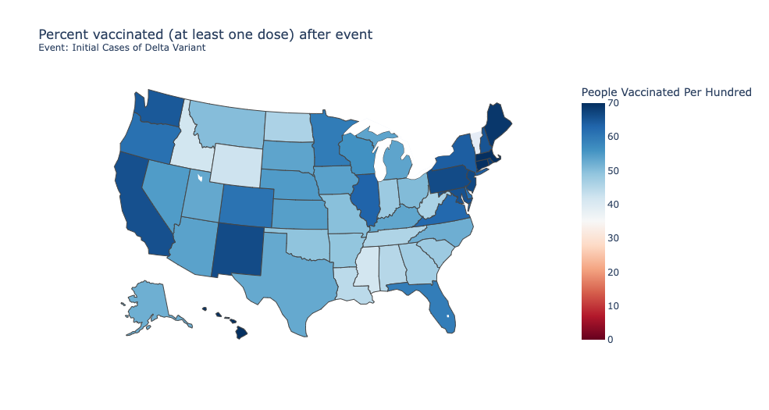
IV
Research Results: Statewide Vaccine Progress
16

Slide 16
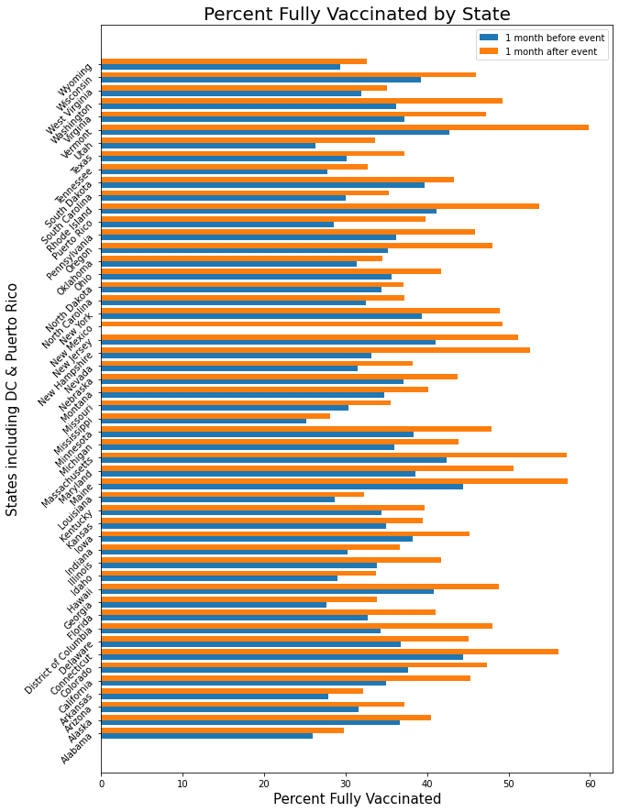
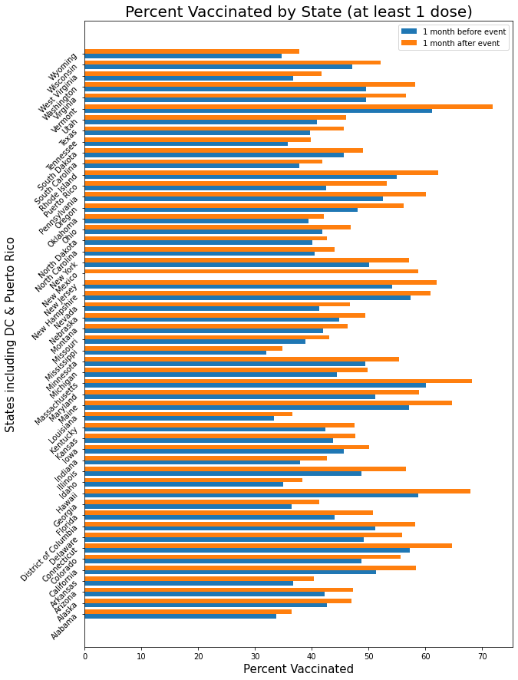
IV
Research Results: Statewide Vaccine Progress
EUA issued for Pfizer vaccine for adolescents, 12-15 years old
States with over 50% of its population fully vaccinated
Vermont, 59.81% Maine, 57.21% Massachusetts, 57.13% Connecticut, 56.08% Rhode Island, 53.81% New Hampshire, 52.62% New Jersey, 51.15% Maryland, 50.50%
17

Slide 17
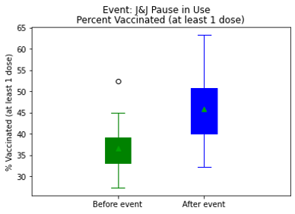
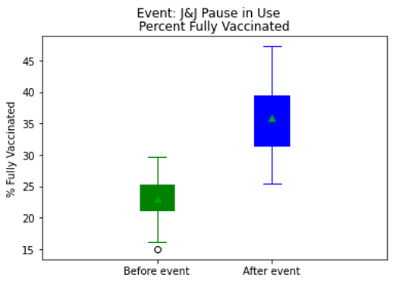
IV
Research Results: Statewide Vaccine Progress
18

Slide 18
Statistical Analysis and Results
19

Slide 19
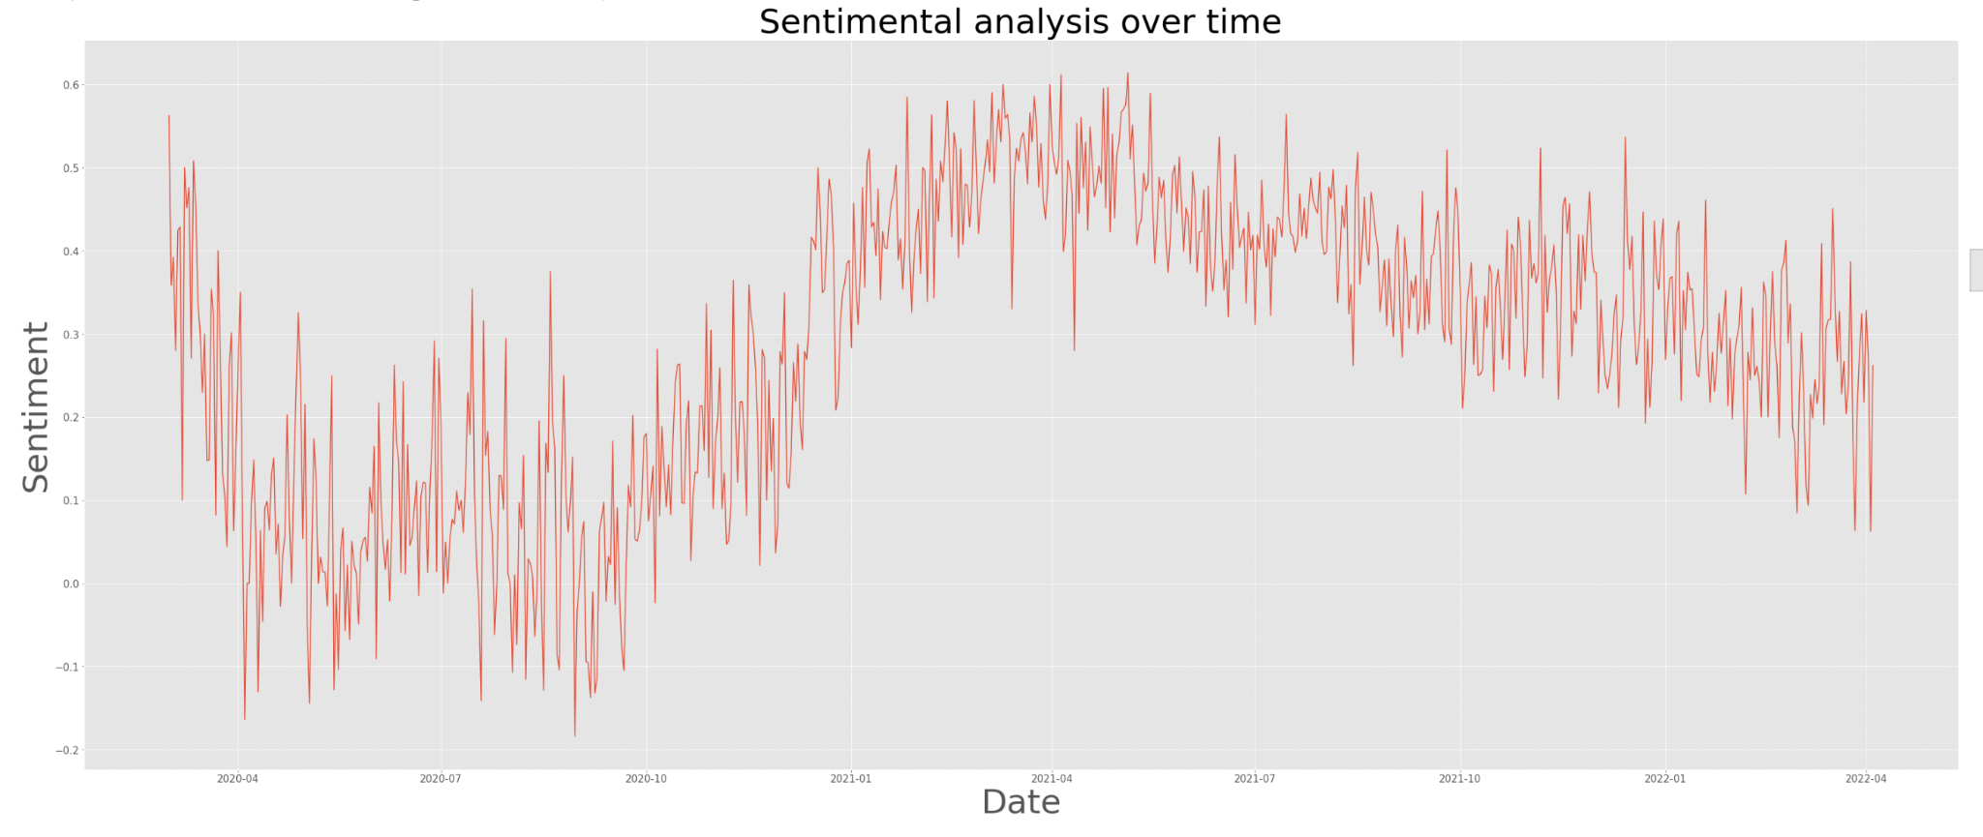
Time series Analysis of the Sentiments:
Observed Value
20

Slide 20
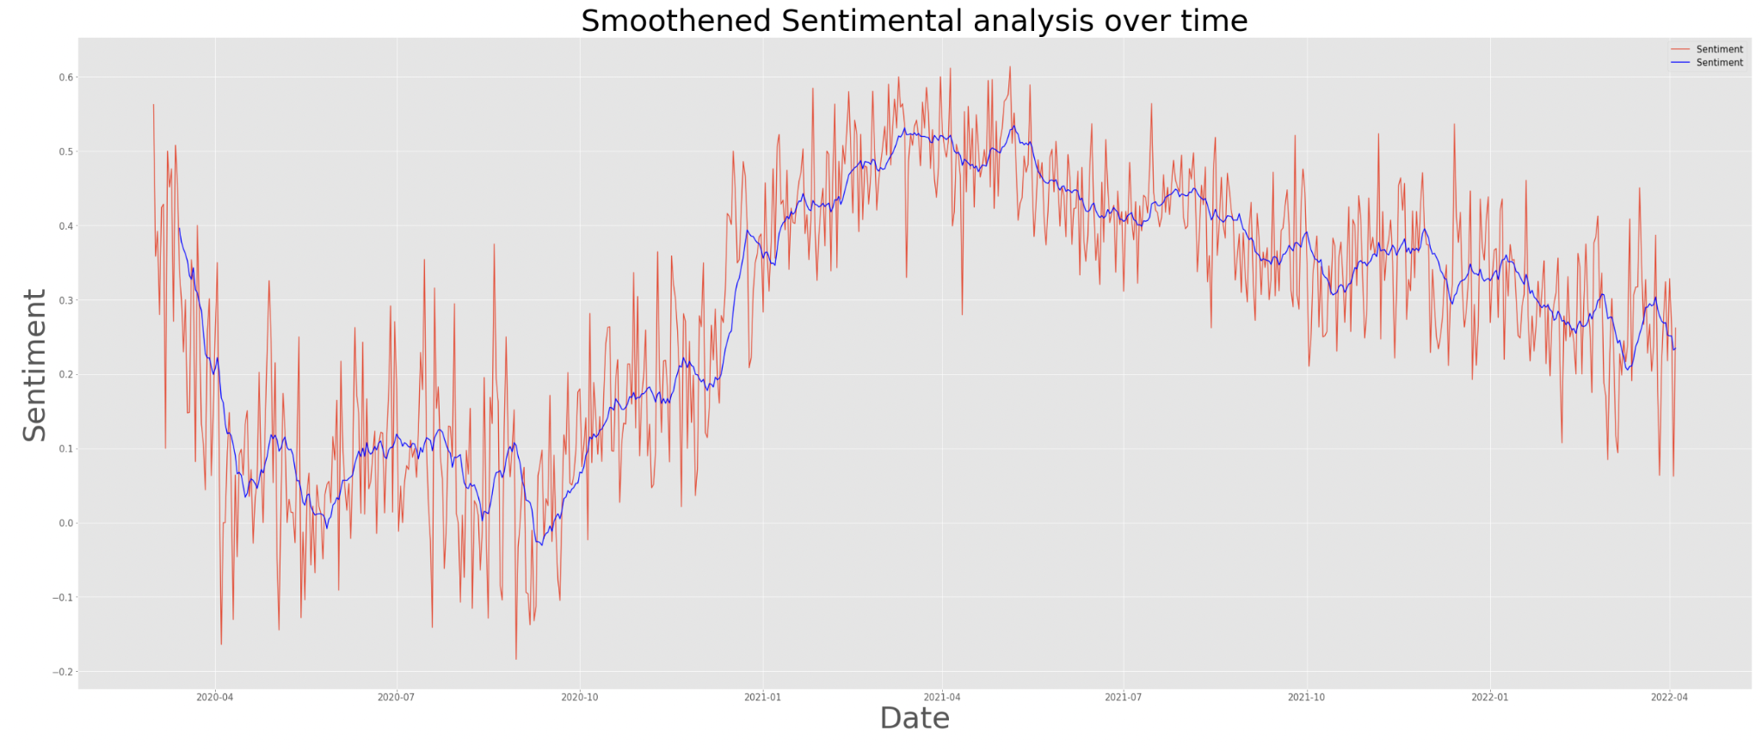
Time series Analysis of the Sentiments:
Observed Value in sentiments after application of smoothening of 14 days window
21

Slide 21
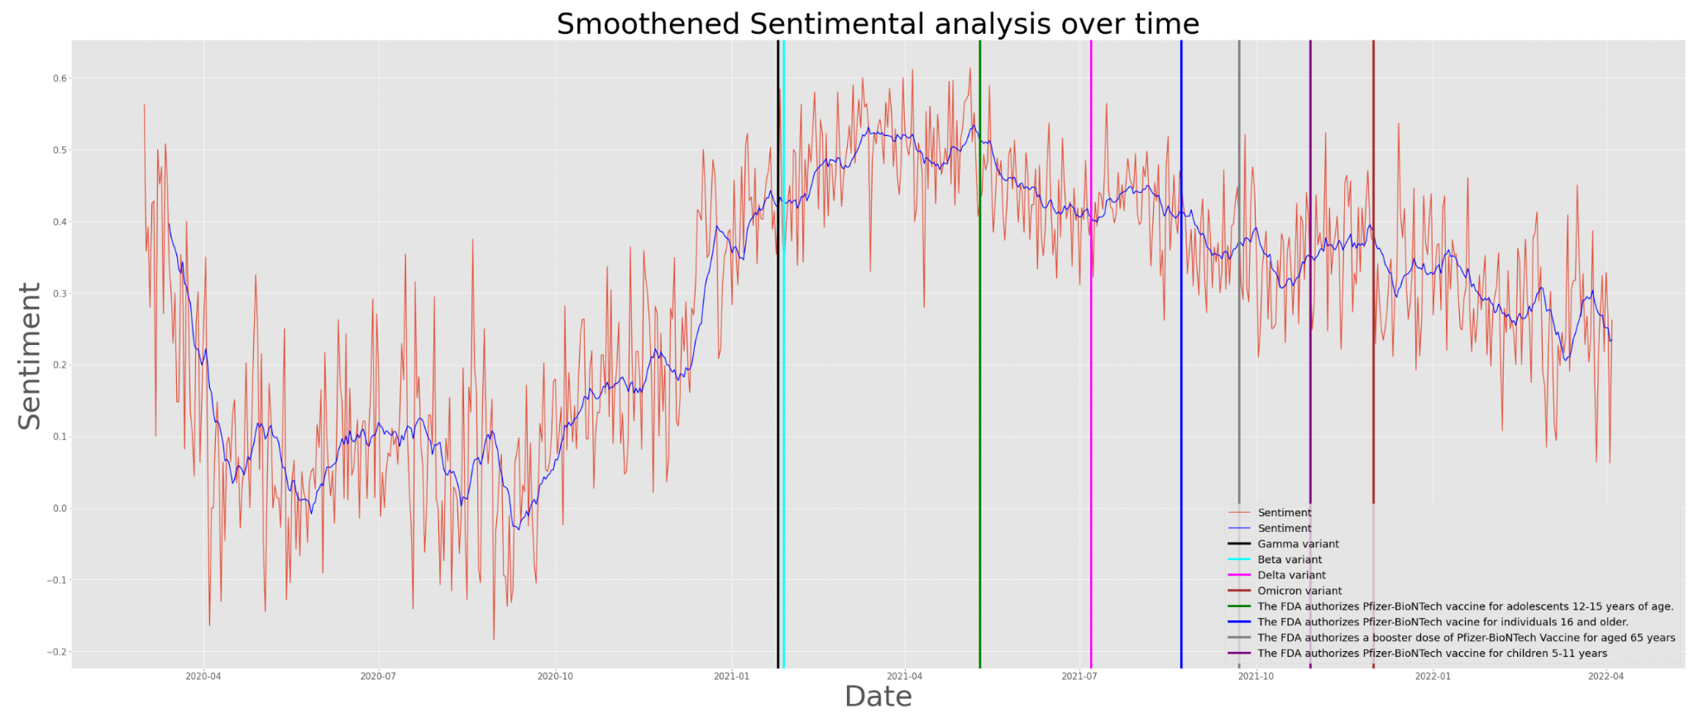
Time series Analysis of the Sentiments:
Observed Value in sentiments after application of smoothening of 14 days window
22

Slide 22
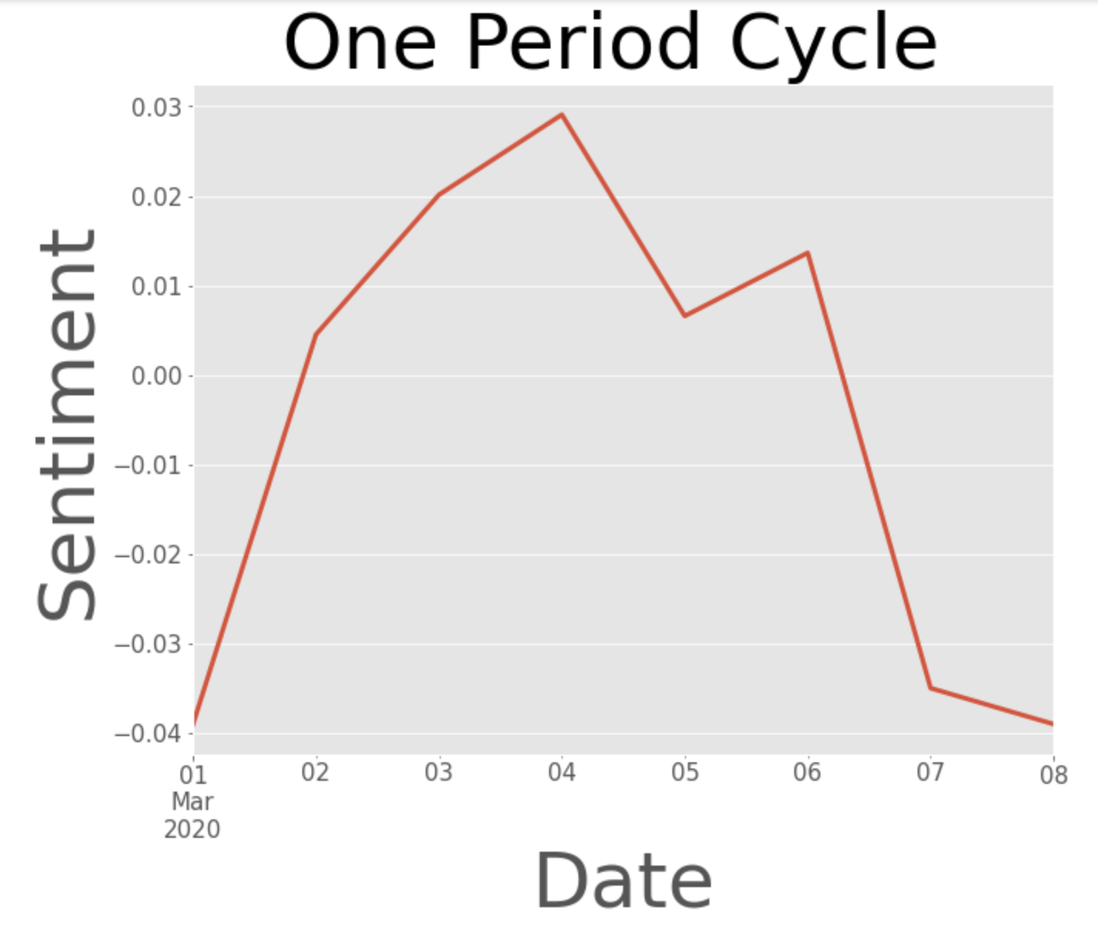
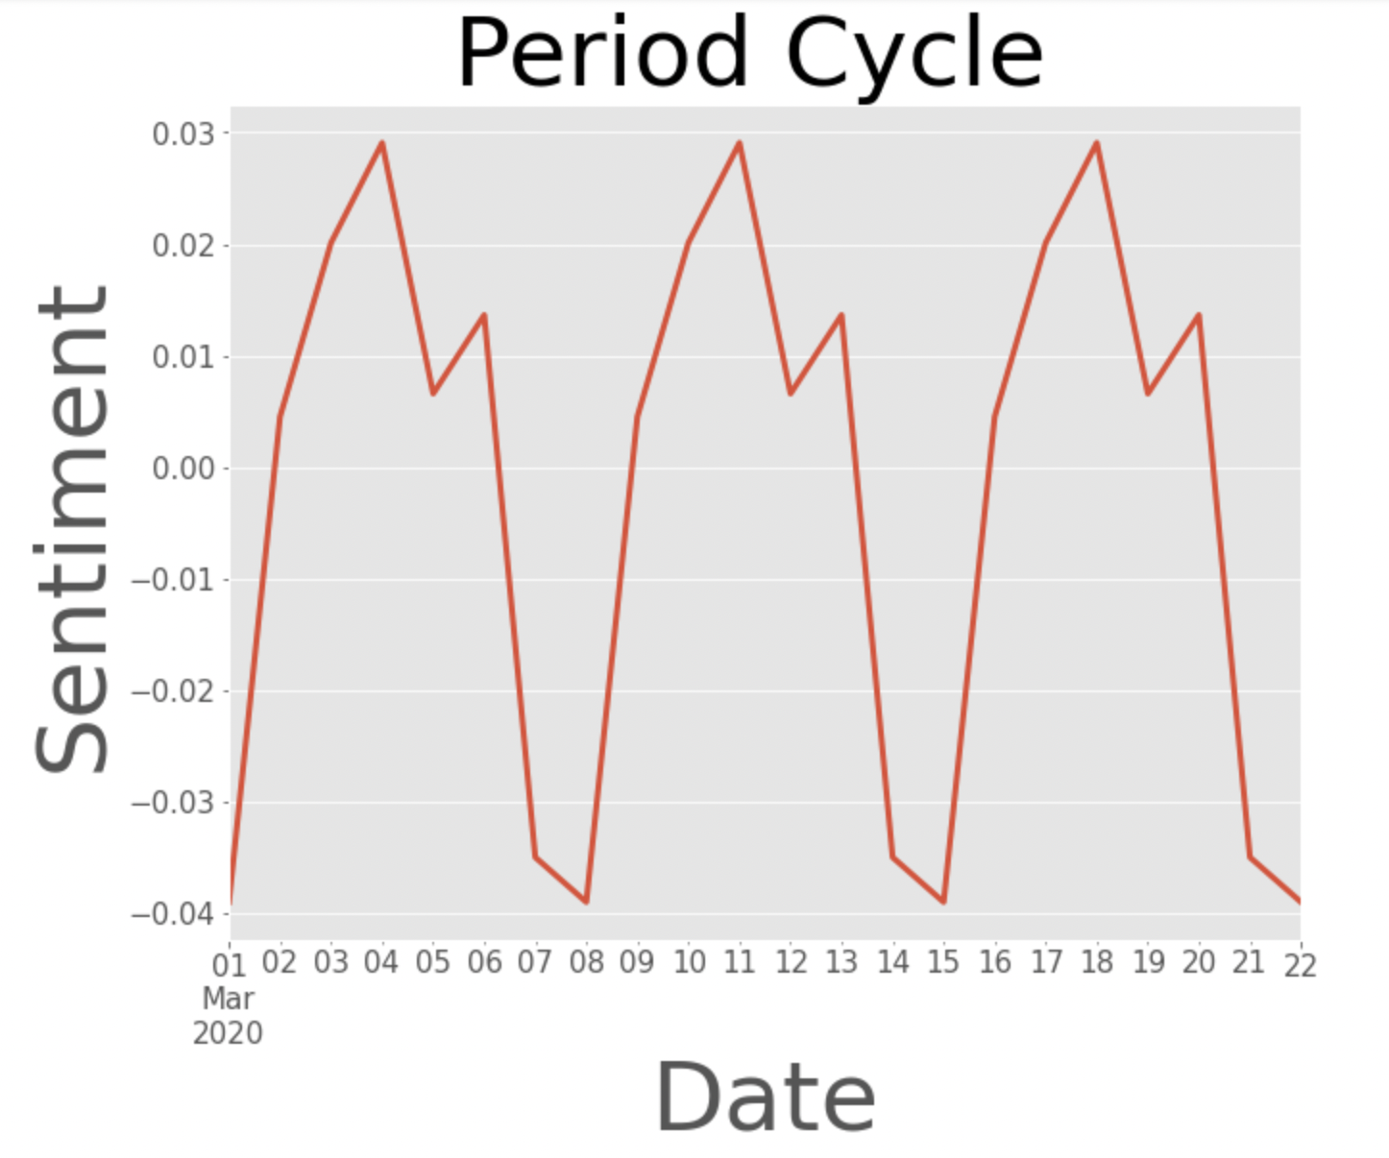
Period Graph
Period of the Seasonality = 8 day
23

Slide 23
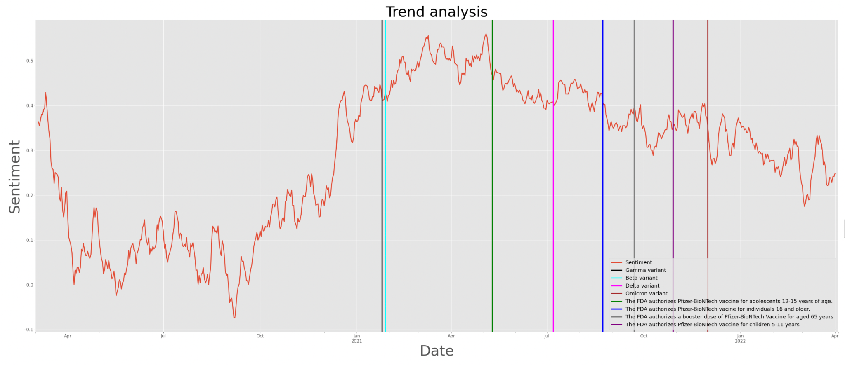
Trend
24

Slide 24
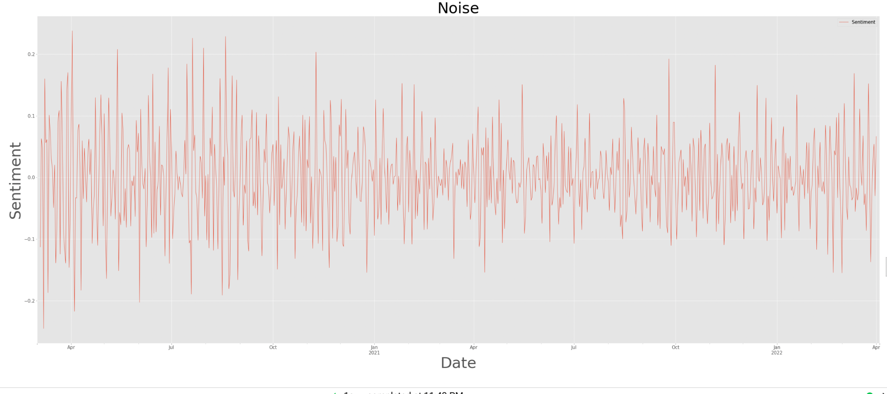
Noise
25

Slide 25
V
Conclusion & Discussions
Hypothesis 1
Sentiment analysis in Red versus Blue states revealed that political affiliations may have little to no effect on the public's sentiment of COVID vaccines.
Hypothesis 2
Sentiments towards COVID vaccines may not be affected by the socioeconomic status of the geographic location and lower rate of COVID vaccination.
Hypothesis 3
Analysis on state-wide vaccination progress revealed that although there was generally a decline in positive sentiment regarding COVID vaccines as the FDA issued EUA approval of COVID vaccines, there was an increase in vaccination rates. It was also found that the pause in use of a particular vaccine brand (J & J vaccine) did not negatively impact sentiment regarding COVID vaccines, nor did it slow down vaccination rates across the United States.
26

Slide 26
V
Conclusion & Discussions
Overall, the majority of the tweets (53.9%) in the United States were positive, while 20.30% were neutral and 15.90% displayed negative sentiment.
Lexicon-based Twitter sentiment analysis is a useful and simple approach for tracking public sentiment regarding COVID-19 vaccinations. High vaccination uptake is critical for ending the epidemic and identifying events that influence vaccine sentiment allows for improved planning and implementation of specific interventions.
27

Slide 27
Winter 2022
University of Michigan
Thank you
for listening!
Questions?

